Slide 1
PFE Project
LL_SW

Slide 2


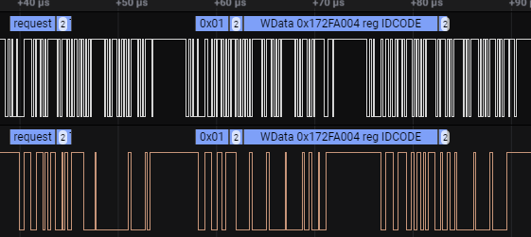
PFE1 : Wireless ST-link Connection (Firas)
Objectif :
Remotely Load & Debugging project to an STM32 target using SWD protocole
Project component
MCU 1
MCU 2
MCU Target
SWD
SWD
Soft Master
Stlink prob
SWD
Soft Slave
UART
UART
Dev
Wifi module
Wifi module
Client apk
Server apk
SWD :Protocol

Slide 3
PFE1 : Wireless ST-link Connection (Firas)
Software Architecture MCU1
EXTI_Callback()
SWD_Slave_Task
StateMachine
Shifter
IN
SWD_CLK
SWD_State Machine
SWD_DATA
EV_RXFLAG/EV_TXFLA
OUT
Stlink prob
OUT
IN
Write data to shfiter
Response From
Target
buffer
IN
OUT
IN
networkTask
Send_Qeue
parserTask
Periodic 20ms
Client apk
IN
OUT
Periodic 20ms
OUT
DMA
Send_To_Server
UART
Wifi module
Client apk

Slide 4
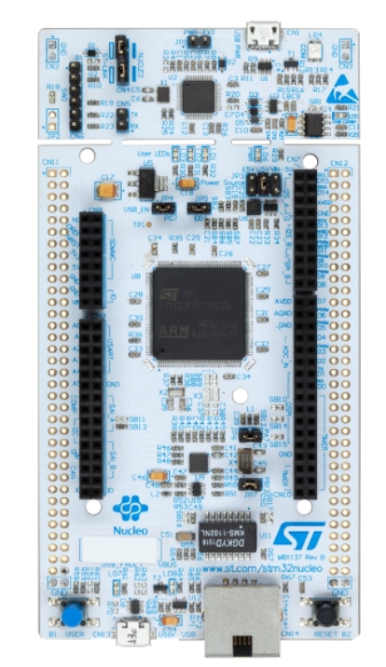
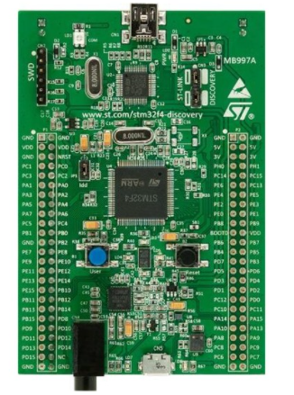
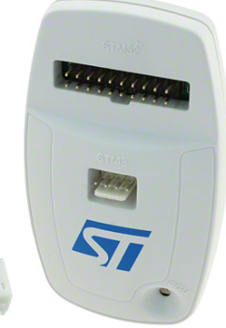
Step1: F7 stlink bridge without wifi
usb
Stlink prob
PD13
swdio
usb
swdio
PE9
PD12
Swd_ck
Swd_ck
PE10
gnd
gnd
gnd
vdd
vdd

Slide 5
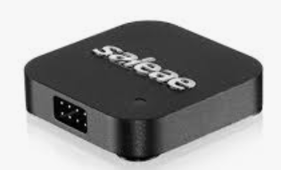
Step1-1: Snif only data & decode step
usb
Stlink prob
usb
PE10
PE9

Slide 6
Step1: F7 stlink bridge without wifi
usb
Stlink prob
PE9
swdio
usb
PE10
Swd_ck

Slide 7
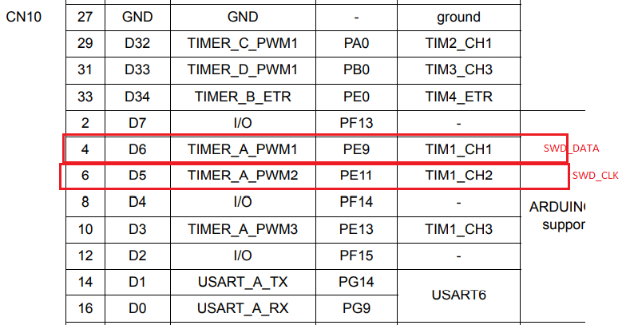
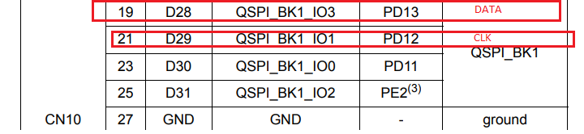
Step1: F7 Pinout for SWD

